Slide 1
Project meeting
IoT Group
2019.06.26

Slide 2
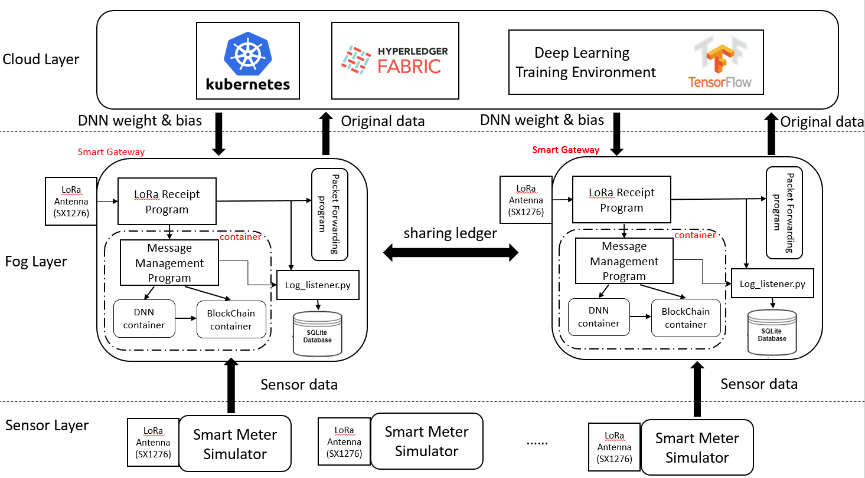
IoT Architecture

Slide 3

Proposed Architecture for Log Data
Smart Gateway
LoRa Antenna
(SX1276)
LoRa Receipt
Program
Packet Forwarding program
container
Message
Management Program
Log_listener.py
DNN
container
BlockChain
container

Slide 4
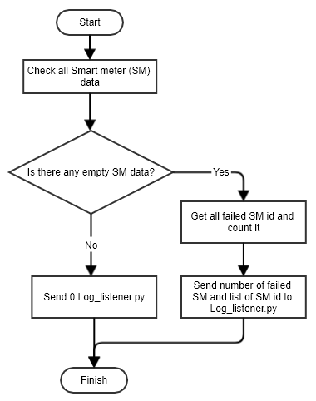
Flowchart for LoRa receiver log

Slide 5
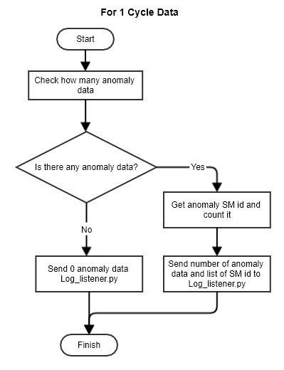
Flowchart for DNN log

Slide 6
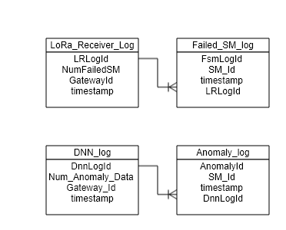
Database Design

Slide 7
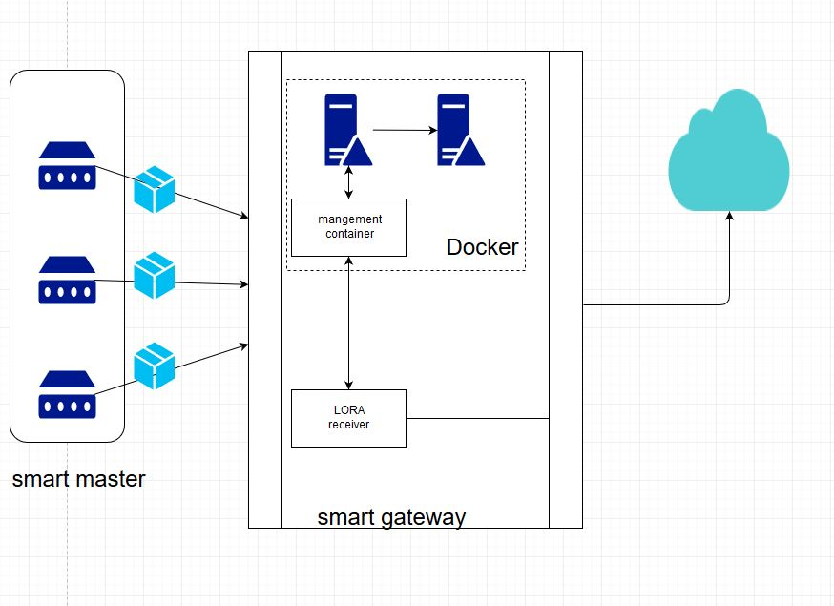
System architecture of Receiver Buffer
Message Management
management
container
Buffer Rearder
LORA Receiver
Buffer

Slide 8
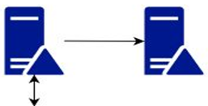
Receiver Buffer on Smart Gateway
Payload
Space
30min
Step by step
200 smart meters
Payload 1
Payload 2
Payload 3
management
container
Docker
Message Management
Buffer Reader

Slide 9
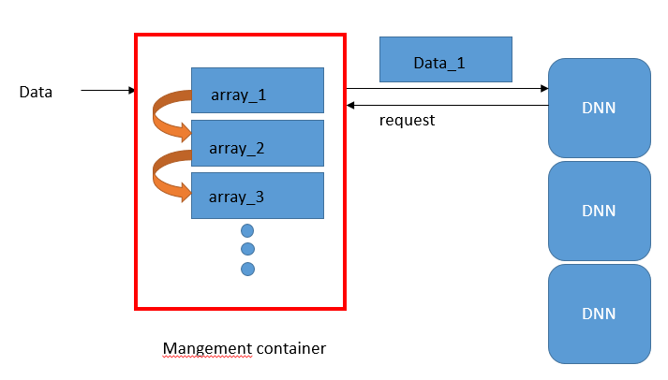
Buffer flow

Slide 10
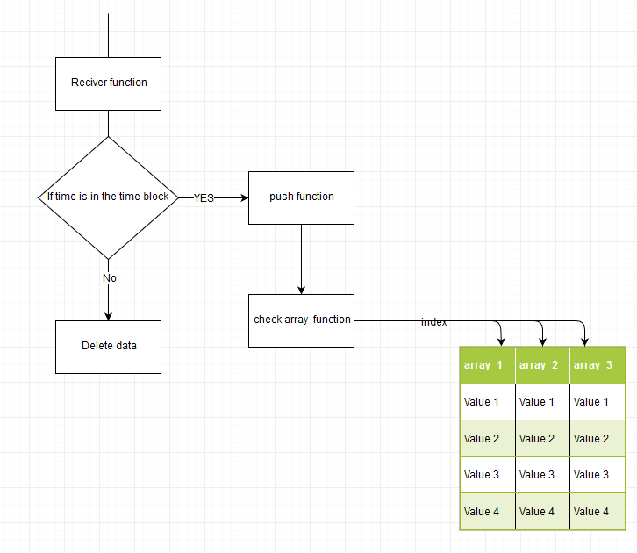
Modify Buff

Slide 11
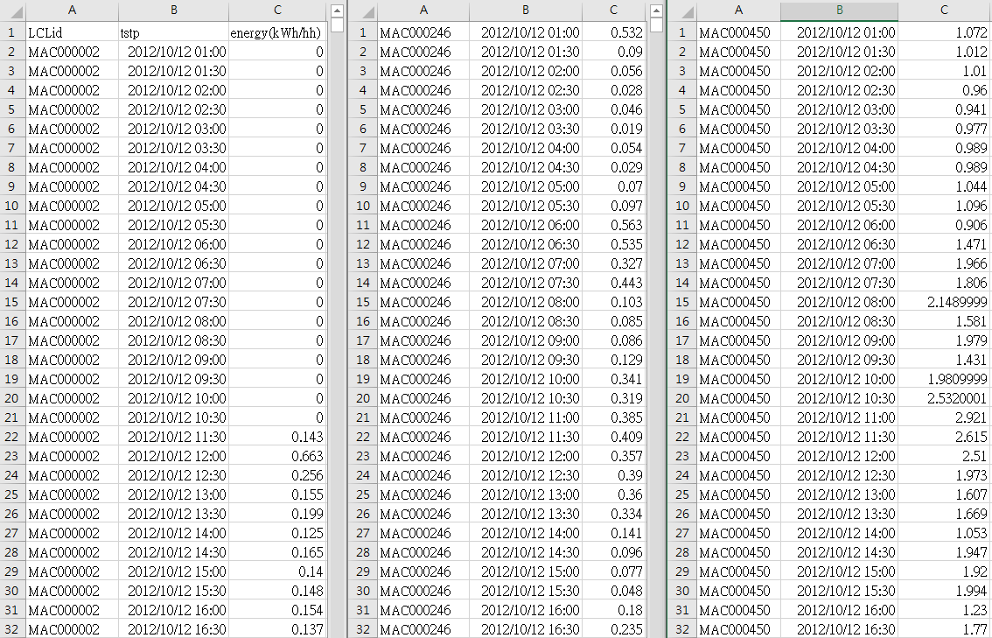
Dataset
Notes:
5600

